Slide 1

Contemporary Hospital Projects
Health – Hospital – Healing
Health – Legislation / Education
Hospital – Infrastructure / Application
Healing – Idea / Practice
FCSI EAME – HOST MILAN 2015

Slide 2
Contemporary Hospital Projects
Health
Vital for living
Cultivated within the body
Normal state for all living creatures
Applies to human, creatures, vegetation, environment w/out any missing
Core of human happiness and well being
Important contribution to economic progress
Develops wealth
FCSI EAME – HOST MILAN 2015

Slide 3
Contemporary Hospital Projects
Legislation
Global – Organized by global actors and NGO s
Local – Regulated by politicians
FCSI EAME – HOST MILAN 2015

Slide 4
Contemporary Hospital Projects
Global legislation
Create virtual enemies to fight against
Make various studies and experiences no one is aware of
What was and is Avian Influenza – Bird Flu
Who created (CCHF) Crimean – Congo hemorrhagic fever?
What is Ebola?
AIDS, SARS?
Flu or chemical threat?
FCSI EAME – HOST MILAN 2015

Slide 5
Contemporary Hospital Projects
Local legislation
Health plans that are not applicable
Security and insurance takes over health
Change of plans too frequently
Lack of social achievable goals
“Money buys service” method
FCSI EAME – HOST MILAN 2015

Slide 6
Contemporary Hospital Projects
Education
Lack of universal medicine knowledge
Under chemical manufacturers’ influence
Malpractices are everywhere
Non – doctors take the role of doctors
Medicine oriented treatment methods
FCSI EAME – HOST MILAN 2015

Slide 7
Contemporary Hospital Projects
Hospital
We know that lack of stable, standard processes creates vast amounts of waste and harm in healthcare that can be alleviated.
We know that hospitals can be built faster, better, and less expensively when disciplines collaborate, such as when integrated project delivery works well.
FCSI EAME – HOST MILAN 2015

Slide 8
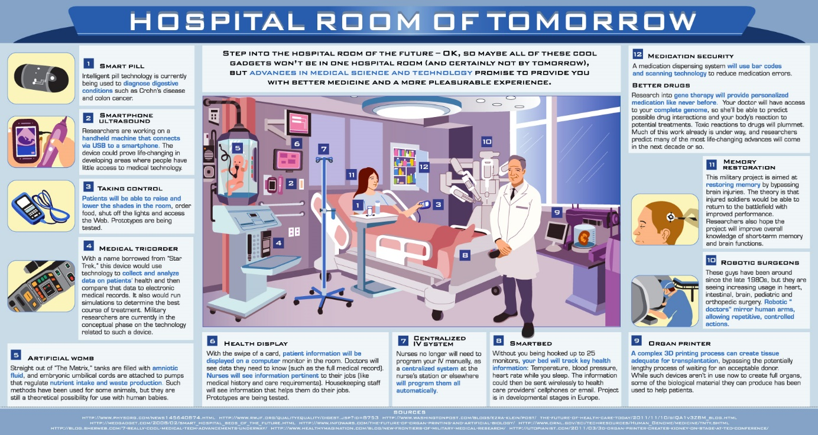
Contemporary Hospital Projects
FCSI EAME – HOST MILAN 2015

Slide 9
Contemporary Hospital Projects
How can the hospital of the future sustainable?
Patient experience will govern healthcare; any effort that does not speed the patient back to health will be recognized as waste.
The hospital will use 100% of its space, 24 hours a day. It will be smaller.
Spaces will flexible among services.
Processes will remain active and improving continuously.
Costs and time frames for design, construction, and operation will decline precipitously.
Cooperation with frontline healthcare workers, hospital executives, architects, and construction experts will be established from day 1 of any construction project, and it will remain sound through move-in.
FCSI EAME – HOST MILAN 2015

Slide 10
Contemporary Hospital Projects
What is healing?
Common objective is to cure disease
There are basically three disease treatment types:
Homeopathy
Allopathy
Ayurveda
FCSI EAME – HOST MILAN 2015

Slide 11
Contemporary Hospital Projects
Homeopathy:
Helps the body to heal itself by improvising its immune system.
Everyone has a different reaction to same disease and healing time varies.
One best thing is that this methodology has no side effects.
The treatment takes a longer period of time.
It is not practical to use in emergency cases.
FCSI EAME – HOST MILAN 2015

Slide 12
Contemporary Hospital Projects
Allopathy:
It is drug oriented methodology and doctors treat a disease based on symptoms not on the causes.
Mainly depends on three things hypothesis, experimentation and the outcome of the experiment.
The pill given to the patient depends on the outcome of the experiment.
So we can say that in allopathy there is a pill for a particular disease.
FCSI EAME – HOST MILAN 2015

Slide 13
Contemporary Hospital Projects
Allopathy:
There is no place for individuality in allopathy because the same pill is given to all the patients having same kind of disease.
Effective in emergency. It is the main reason why people around the world adopted allopathy.
Most of the drugs given in allopathy have side effects internal or external.
The pill given to cure a disease is also giving birth to another disease in the body.
FCSI EAME – HOST MILAN 2015

Slide 14
Contemporary Hospital Projects
Ayurveda:
It is ancient medical science of Eastern world.
There are three types of elemental energies in human body and a disease is caused due to imbalance of any of these three energies called doshas. The three doshas are
1). Vata (air or wind)
2). Pitta (fire or bile)
3). Kapha (earth or bodily fluids or phlegm or mucous)
FCSI EAME – HOST MILAN 2015

Slide 15
Contemporary Hospital Projects
Ayurveda:
All the above faults or doshas are called tridoshas in ayurveda.
The imbalance of any of these doshas in our body causes the disease.
Every physician in ayurveda has different remedy for a same kind of disease.
It is dependent on the medicinal plants for treating a disease.
Has very low count of side effects which are due to the lack of knowledge of the physician.
FCSI EAME – HOST MILAN 2015

Slide 16
Contemporary Hospital Projects
The current problems in health systems
Unexpected diseases
Ageing of the population
The population goes sicker and poorer
Health plans based on insurance and payment methodologies
Readmission rate so high – 1 to 5 hospitalized Medicare beneficiaries experience an unplanned readmission within 30 days
FCSI EAME – HOST MILAN 2015

Slide 17
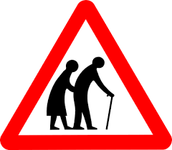
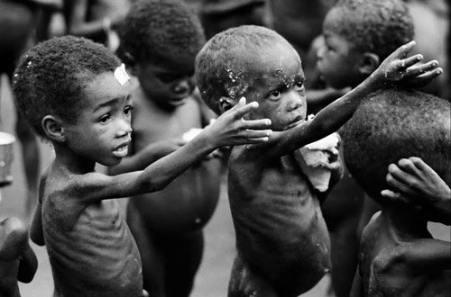
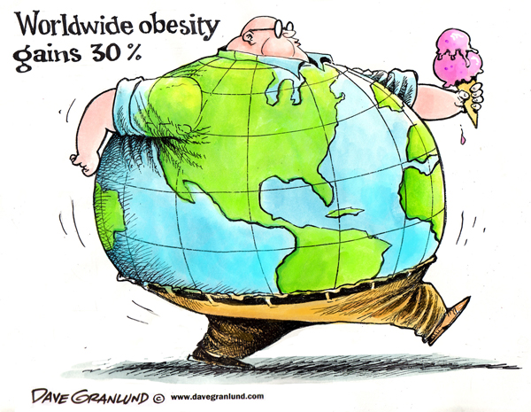
Contemporary Hospital Projects
FCSI EAME – HOST MILAN 2015

Slide 18
Contemporary Hospital Projects
Population versus Medical Services
Disease prevention can reduce the health sector’s climate footprint
Climate mitigation can contribute to public health care systems money
Sourcing and serving healthy food can reduce hospitals’ climate footprint and improve patient health
Sustainable health care waste management cuts emissions
FCSI EAME – HOST MILAN 2015

Slide 19
Contemporary Hospital Projects
Key facts
At least a billion people suffer each year because they cannot obtain the health services they need.
People centered and integrated health services are critical for reaching universal health coverage.
About 150 million of the people who do use health services are subjected to financial catastrophe annually, and 100 million are pushed below the poverty line as a result of paying for the services they receive.
FCSI EAME – HOST MILAN 2015

Slide 20
Contemporary Hospital Projects
Key facts
In the next twenty years, 40-50 million new health care workers will need to be trained and deployed to meet the need.
Globally, two-thirds (38 million) of 56 million annual deaths are still not registered.
Serving healthy and sustainably grown food is as essential to the health of our community as the medical care we provide.
FCSI EAME – HOST MILAN 2015

Slide 21
Contemporary Hospital Projects
Global health situation
Life expectancy at birth increased globally by 6 years since 1990.
Around 6.6 million children under the age of 5 die each year.
Preterm birth is the leading killer of newborn babies.
Cardiovascular diseases are the leading causes of death in the world.
Most HIV/AIDS deaths occur in Africa.
Every day, about 800 women die due to complications of pregnancy and childbirth.
FCSI EAME – HOST MILAN 2015

Slide 22
Contemporary Hospital Projects
Global health situation
Mental health disorders such as depression are among the 20 leading causes of disability worldwide.
Tobacco, alcohol, drugs kills nearly 6 million people each year.
Almost 1 in 10 adults has diabetes.
Nearly 3.500 people die from road traffic crashes every day.
FCSI EAME – HOST MILAN 2015

Slide 23
Contemporary Hospital Projects
Obesity facts and features
Overweight and obesity are defined as “abnormal or excessive fat accumulation that may impair health”
More than 1.9 billion adults,18 years and older, were overweight in 2014, and more than 600 million obese.
Globally, 42 million preschool children under the age of 5 were overweight in 2013.
Overweight and obesity are linked to more deaths worldwide than underweight.
For an individual, obesity is usually the result of an imbalance between calories consumed and calories expended.
FCSI EAME – HOST MILAN 2015

Slide 24
Contemporary Hospital Projects
Obesity facts and features
Supportive environments and communities are fundamental in shaping people’s choices and preventing obesity.
Children choices, diet and physical activity habits are influenced by their surrounding environment.
Eating healthy diet can help prevent obesity.
Regular physical activity helps maintain a healthy body.
Curbing the global obesity epidemic requires a population-based multi-sectoral, multi-disciplinary, and cultural relevant approach.
Obesity is preventable!
FCSI EAME – HOST MILAN 2015

Slide 25
Contemporary Hospital Projects
Universal health coverage
Universal coverage that all people can use health services without financial hardship
All people should have access to the health services they need
Out of pocket payments push 100 million people into poverty every year
The most effective way to provide universal coverage is to share the cost across the population
All countries are continually seeking more funds for health care
FCSI EAME – HOST MILAN 2015

Slide 26
Contemporary Hospital Projects
Universal health coverage
In 2010, 79 countries devoted less than 10% of government expenditure to health
Countries are finding innovative ways to raise revenue for health
Only eight of the world’s 49 poorest countries have any chance of financing a set of basic services with their own domestic resources by 2015
Globally, 20-40% of resources spent on health are wasted
All countries can do more in order to move towards universal coverage
FCSI EAME – HOST MILAN 2015

Slide 27

Contemporary Hospital Projects
FCSI EAME – HOST MILAN 2015

Slide 28
Contemporary Hospital Projects
Food safety
More than 200 diseases are spread through food.
Contaminated food can cause long-term health problems.
Foodborne diseases affect vulnerable people harder than other groups.
There are many opportunities for food contamination to take place.
Globalization makes food safety more complex and essential.
Food safety is multi-sectoral and multidisciplinary.
Food contamination also affects the economy and society as a whole.
Some harmful bacteria are becoming resistant to drug treatments.
Everybody has a role to play in keeping food safe.
Consumers must be well informed on food safety practices.
FCSI EAME – HOST MILAN 2015

Slide 29
Contemporary Hospital Projects
What are health care-associated infections?
Health care-associated infections, or infections acquired in health-care settings are the most frequent adverse event in health-care delivery worldwide.
Hundreds of millions of patients are affected by health care-associated infections worldwide each year, leading to significant mortality and financial losses for health systems.
In high-income countries, approximately 30% of patients in intensive care units (ICU) are affected by at least one health care-associated infection.
FCSI EAME – HOST MILAN 2015

Slide 30
Contemporary Hospital Projects
What are health care-associated infections?
In low- and middle-income countries the frequency of ICU-acquired infection is at least 2─3 fold higher than in high-income countries; device-associated infection densities are up to 13 times higher than in the USA.
Health care-associated infections only usually receive public attention when there are epidemics.
FCSI EAME – HOST MILAN 2015

Slide 31
Contemporary Hospital Projects
What factors put patients at risk of infection in health-care settings?
Insufficient application of standard and isolation precautions;
Some determinants are more specific to settings with limited resources;
Inadequate environmental hygienic conditions and waste disposal;
Poor infrastructure;
Insufficient equipment;
Understaffing;
Overcrowding;
Poor knowledge and application of basic infection control measures;
FCSI EAME – HOST MILAN 2015

Slide 32
Contemporary Hospital Projects
What is the impact of health care-associated infections?
As is the case for many other patient safety issues, health care-associated infections create additional suffering and come at a high cost for patients and their families.
Infections prolong hospital stays, create long-term disability, increase resistance to antimicrobials, represent a massive additional financial burden for health systems, generate high costs for patients and their family, and cause unnecessary deaths.
FCSI EAME – HOST MILAN 2015

Slide 33
Contemporary Hospital Projects
What is the impact of health care-associated infections?
Such infections annually account for 37.000 attributable deaths in Europe and potentially many more that could be related, and they account for 99.000 deaths in the USA.
Annual financial losses due to health care-associated infections are also significant: they are estimated at approximately €7 billion in Europe, including direct costs only and reflecting 16 million extra days of hospital stay, and at about US$ 6.5 billion in the USA.
FCSI EAME – HOST MILAN 2015

Slide 34
Contemporary Hospital Projects
How to solve the problem?
1. Financial mechanism
Which financing mechanisms are most appropriate for capital investments in hospitals?
Health care is labor intensive and health care workers are at the heart of health systems, and thus of the changes taking place in hospitals.
However, most health systems struggle to achieve the right numbers, skill mix, and distribution of the health care workforce.
FCSI EAME – HOST MILAN 2015

Slide 35
Contemporary Hospital Projects
How to solve the problem?
2. Life cycle of health facilities
How can the entire life-cycle of health facilities be taken into account at the initial design stage?
New achievement or remedy against health systems is forced to change directions which promotes health tourism.
But this has many obstacles related with cultural differences, language problems, climate change, high costs even compensated by the governments.
FCSI EAME – HOST MILAN 2015

Slide 36
Contemporary Hospital Projects
How to solve the problem?
3. Sustainable hospitals
How can hospitals be made more sustainable and adaptable to future changes?
The staff and resources from large centers will increasingly form part of a network, with smaller hospitals, services in the community and enhanced primary care providing elements of the care pathway.
The specialist centers may retain the work that requires high levels of expertise or multidisciplinary teamwork and responsibility for overseeing education and clinical elements, but they nevertheless will be part of a network and dependent on it.
FCSI EAME – HOST MILAN 2015

Slide 37
Contemporary Hospital Projects
How to solve the problem?
4. Models of care on hospital functions
What is the impact of systematized models of care on hospital functioning?
This makes the planning of hospitals a much more difficult task.
Planners have to identify the various streams of activity, determine the different options for how these services can be provided and what the most appropriate and cost-effective solution might be, and then project how demand, technology and a range of other uncertain environmental factors are likely to change this.
FCSI EAME – HOST MILAN 2015

Slide 38
Contemporary Hospital Projects
How to solve the problem?
5. Hospital construction concept
How the hospital should be structured conceptually (as an entity responding to service needs) and as an actual building?
The situation is complicated further by the diverse needs of those using health care systems.
There is particular uncertainty about how best to configure services for children.
Much of the historical hospital workload (dominated by infectious diseases) has decreased markedly.
FCSI EAME – HOST MILAN 2015

Slide 39
Contemporary Hospital Projects
How to solve the problem?
5. Hospital construction concept
How the hospital should be structured conceptually (as an entity responding to service needs) and as an actual building?
On the one hand, there is growing need for community services addressing issues such as psychological disorders, while at the same time, the care provided in hospitals – now dominated by cancers, chronic diseases and genetic disorders – has become vastly more complex.
FCSI EAME – HOST MILAN 2015

Slide 40
Contemporary Hospital Projects
Present and future challenges
Patterns of disease have changed throughout human history,
Old diseases disappearing and new ones emerging
New infectious threats may suddenly appear
Most of the times they are almost impossible to predict
The rise of hospital-acquired infections, such as Methicillin Resistant Staphylococcus Aureus (MRSA)
FCSI EAME – HOST MILAN 2015

Slide 41
Contemporary Hospital Projects
Possible changes
Changing lifestyles will also result in changing patterns of ill health.
The spread of unhealthy diets and fast food create big health issues
In many countries heart disease and other diet-related diseases are at peak level.
Progression of the tobacco epidemic in many countries be expected to lead to an increase in tobacco-related morbidity and mortality.
Drug legalization will bring many problems in the years to come.
FCSI EAME – HOST MILAN 2015

Slide 42
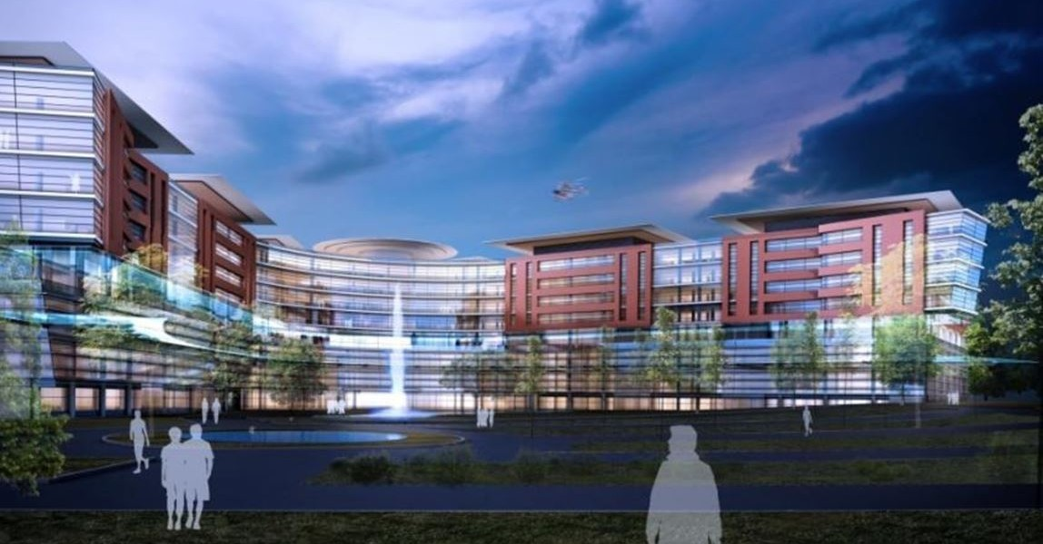
Contemporary Hospital Projects
FCSI EAME – HOST MILAN 2015

Slide 43
Contemporary Hospital Projects
Evolution
Models of care setting
From: Hospital-based care (accident and emergency, inpatient wards, day-case surgery, outpatient clinics) and general practice
To: A community-based outpatient clinic which operates openly as a multi-agency one stop shop
FCSI EAME – HOST MILAN 2015

Slide 44
Contemporary Hospital Projects
Evolution
Nature of intervention
From: Specialized clinical treatment
To: Remote IT monitoring, secondary prevention and psychosocial support
FCSI EAME – HOST MILAN 2015

Slide 45
Contemporary Hospital Projects
Evolution
Duration of care
From: Extended inpatient admission
To: Health provision from multiple service settings, including health and social care and the voluntary sector
FCSI EAME – HOST MILAN 2015

Slide 46
Contemporary Hospital Projects
Evolution
Social construction of the patient
From: Passive and dependent
To: An engaged co-producer with rights and responsibilities
FCSI EAME – HOST MILAN 2015

Slide 47
Contemporary Hospital Projects
Cause
Disease is caused by mistakes in the habits of living.
Remedy
Correct the mistakes of living, the thinking goes, and disease will take care of itself.
FCSI EAME – HOST MILAN 2015

Slide 48
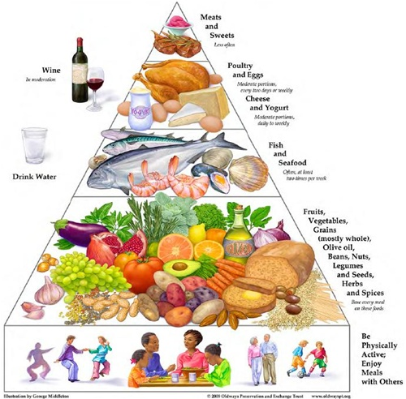
Contemporary Hospital Projects
FCSI EAME – HOST MILAN 2015

Slide 49
Contemporary Hospital Projects
Hospital – Health – Healing
Nutrition and health increasing exponentially
Genetics show what and how we eat through metabolism
Our genes express how we feed ourselves
We can influence our bodies through what we eat
FCSI EAME – HOST MILAN 2015

Slide 50
Contemporary Hospital Projects
The medicine of the future
No longer be remedial
It will be preventive
Not based on drugs
On the best diet for health
FCSI EAME – HOST MILAN 2015

Slide 51
Contemporary Hospital Projects
2500 years ago, Hippocrates, the "Father of Medicine", said to his students,
"Let thy food be thy medicine and thy medicine be thy food"
Good luck for your new venture.
FCSI EAME – HOST MILAN 2015

Slide 52

Contemporary Hospital Projects
Thank you
Kadir Serdar Saglamtunc, FCSI
DM Consulting Engineering LLC
PO Box:50, 06550 Çankaya
Ankara - Turkey
FCSI EAME – HOST MILAN 2015

